Slide 1
Golf Ball Printing with XTS

Slide 2
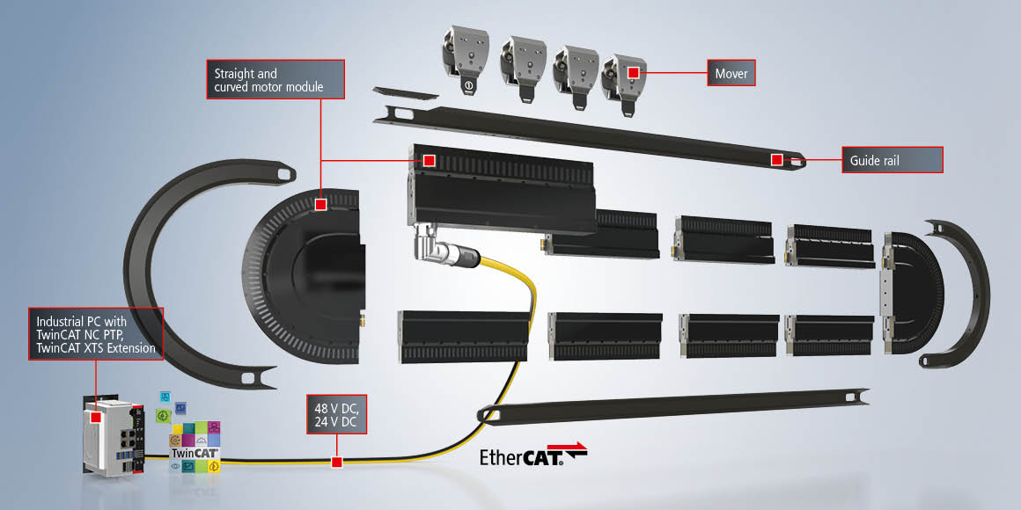
XTS Overview
Notes:
Hello I'm Cope Walker with Beckhoff Automation, and this is our XTS, the eXtended Transport System. It
combines the benefits of rotary and linear systems into a single mechatronic system.
The system can be oriented in any installation position and has a variety of motor types that allow many possible shapes of the resulting track
Several movers can move independently on a single track. Groups of movers can be joined together and commanded as one.
Movers automatically accumulate themselves providing a buffer for processing stations thanks to integrated collision avoidance
Movers can be synchronized to external setpoints for coordinated motion, follow other movers with a defined clamping force, and all other functions available in twincat as servo axes. All of this can be accomplished at up to 4 meters per second, up to 10kg payload, and with a position repeatability of 10um.

Slide 3
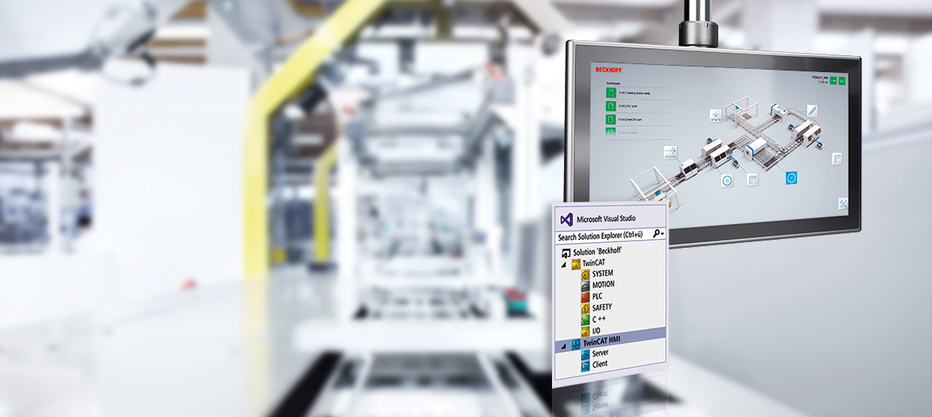
Twincat HMI Overview
Notes:
Twincat HMI is a web based HMI solution from Beckhoff
Resizeable, so one HMI can be configured to work on a variety of devices with different resolutions and aspect ratios
Main HMI panel plus mobile diagnostics tablet for example
Opened in Web Browser
Fully featured example template
Built in tools for easy diagnostics implementation (error screen, ethercat diagnostics, XTS)

Slide 4
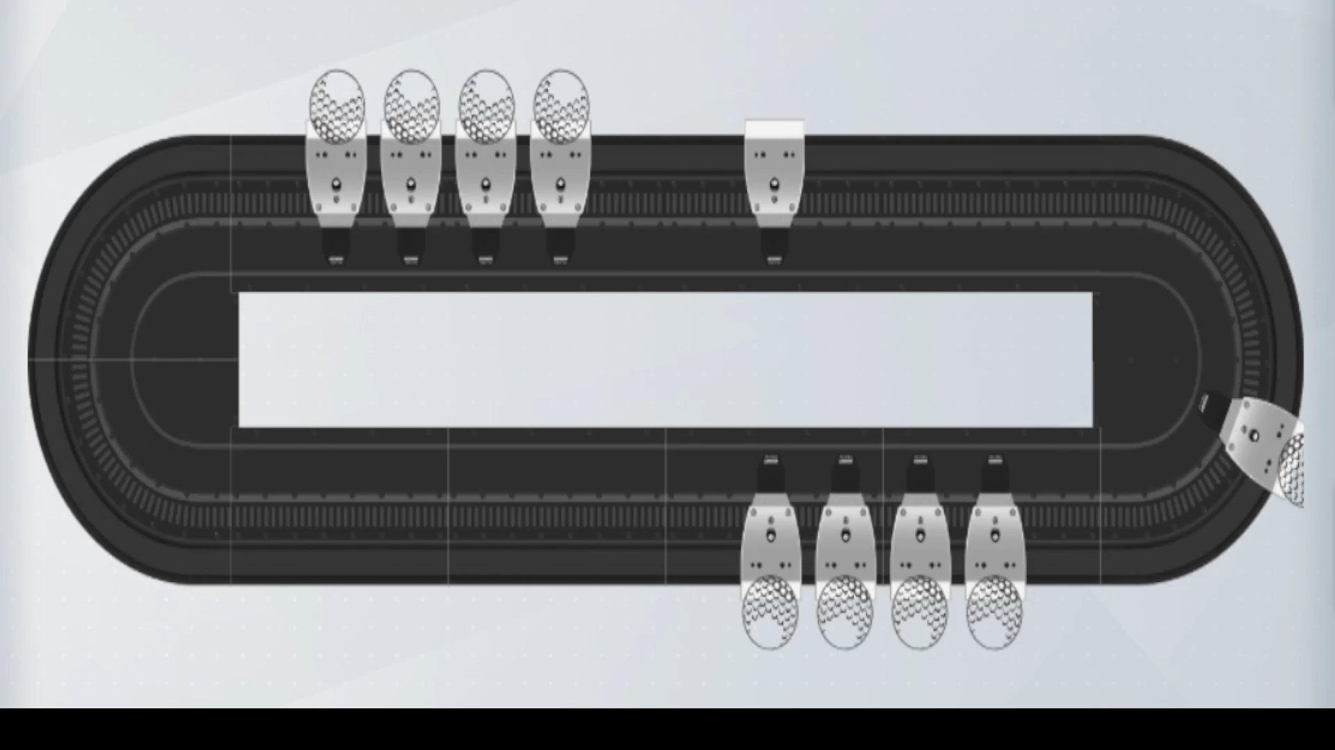
Ball Printing Overview
Tray Load
Orient
Ball Seat
Kickout
Vision
Print
Notes:
Machine Function Explanation

Slide 5
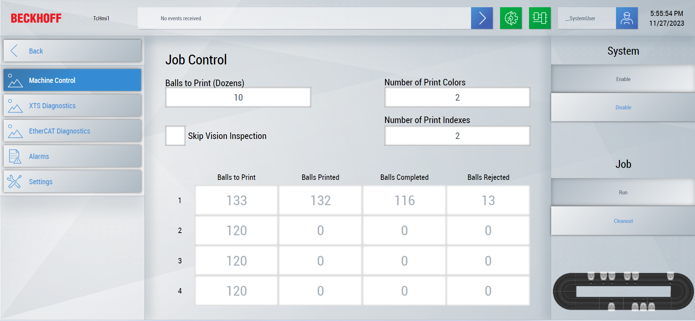
Job Control

Slide 6
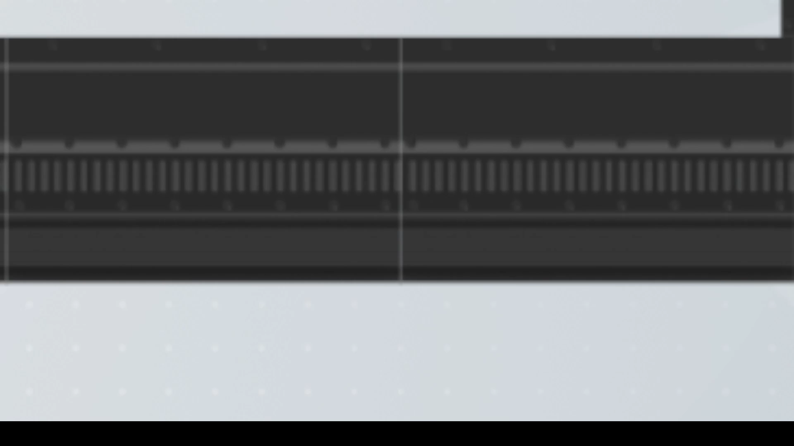
Print Configurations
 |  | Color Count | Color Count
Index Count |  | 1 | 2 | 3 | 4
 | 1
 | 2
Index Count | 3
 | 4
Notes:
Explain “Color Count” then “Index Count” then show videos

Slide 7
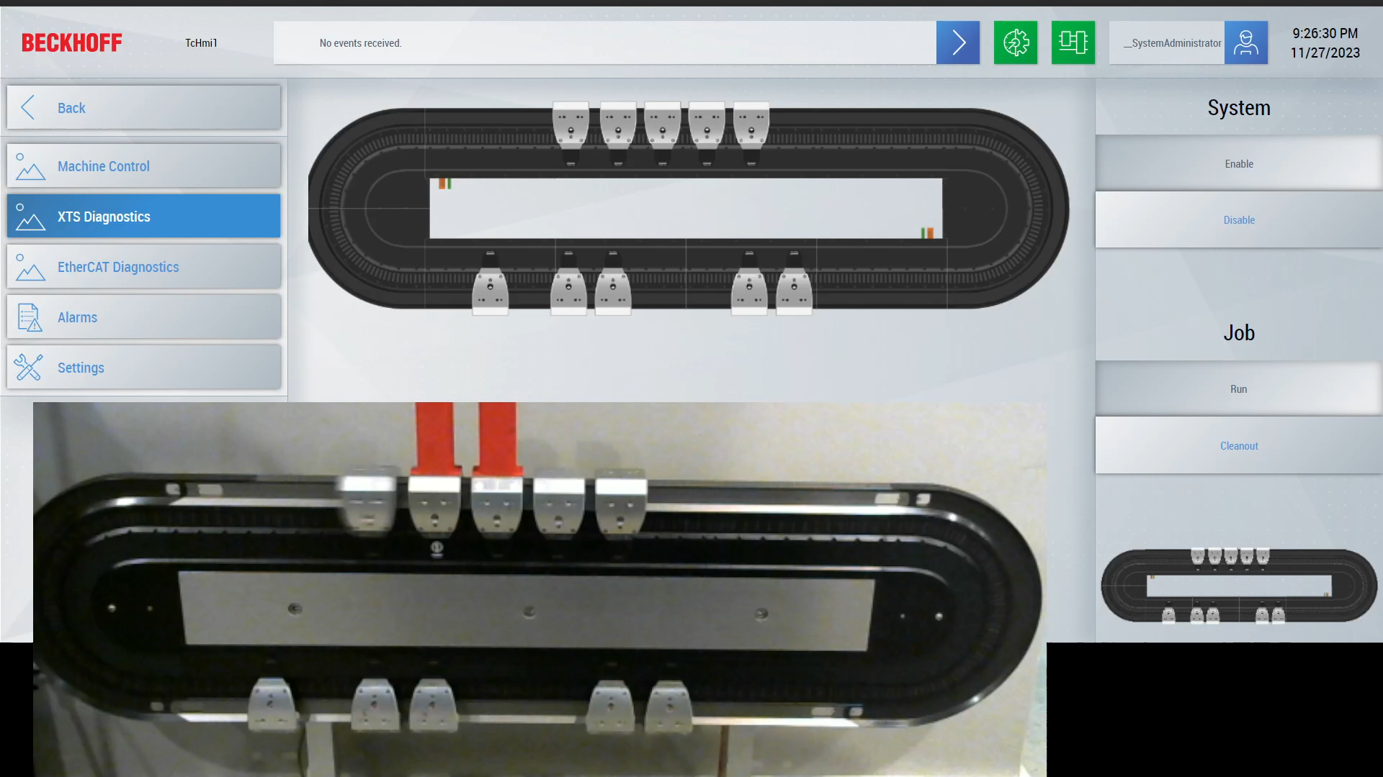
Digital Twin

Slide 8
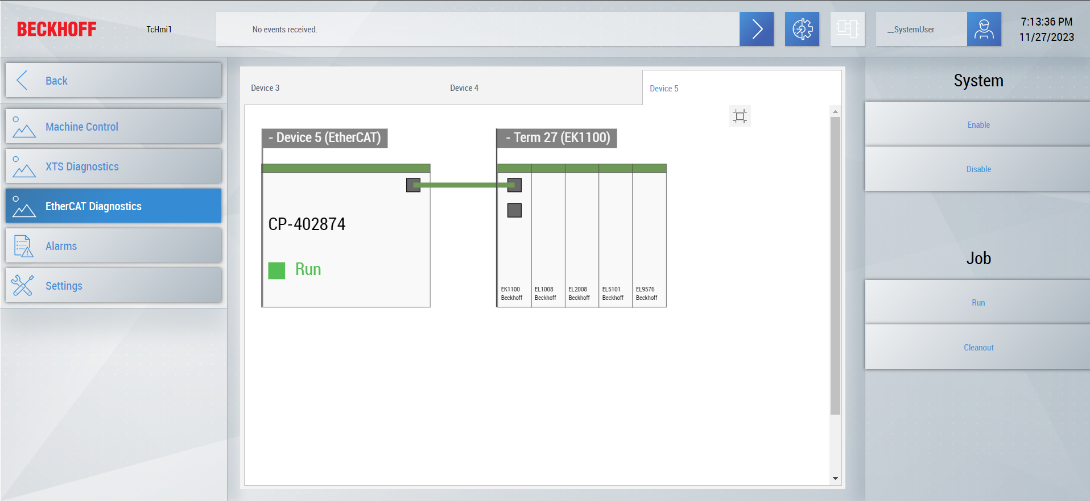
Ethercat Diagnostics

Slide 9
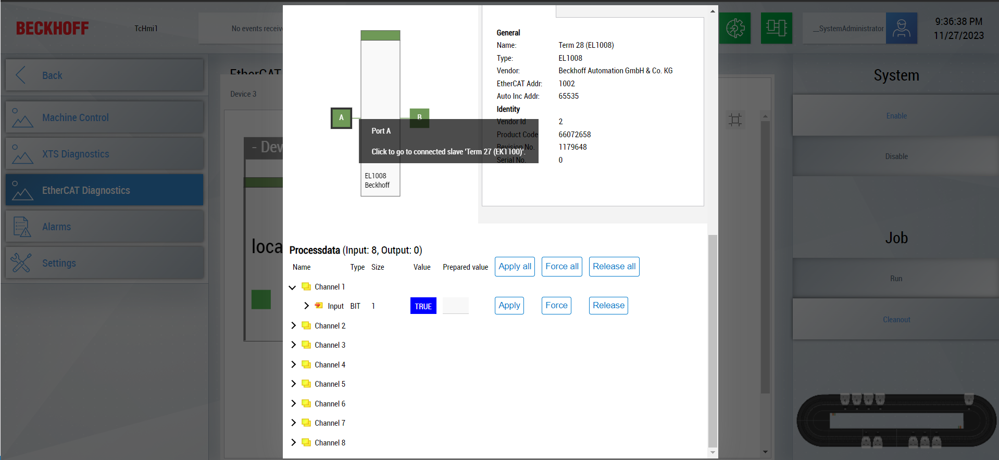
Ethercat Diagnostics
Notes:
Last slide before project background info

Slide 10
Project Background and Motivation
Done by Cope Walker and Daniel Barr
Based off project done with AcoposTrak for Titleist
Wanted a structured project to learn on with explicit tasks and goals
Wrote out a machine spec before starting development
Engineering Competancies
Background
Twincat with Source control
Two solutions with shared PLC project and TC HMI project
Indepedent IO configuration
XTS Configuration for Real and Simulated hardware
Twincat PLC programming
OOP
Debugger
Scope
TC HMI
General controls, XTS Control, Ethercat Diagnostics, ADS mapping, publishing, debug

Slide 11
Real Machine Video

Slide 12
XTS Tuning

Slide 13
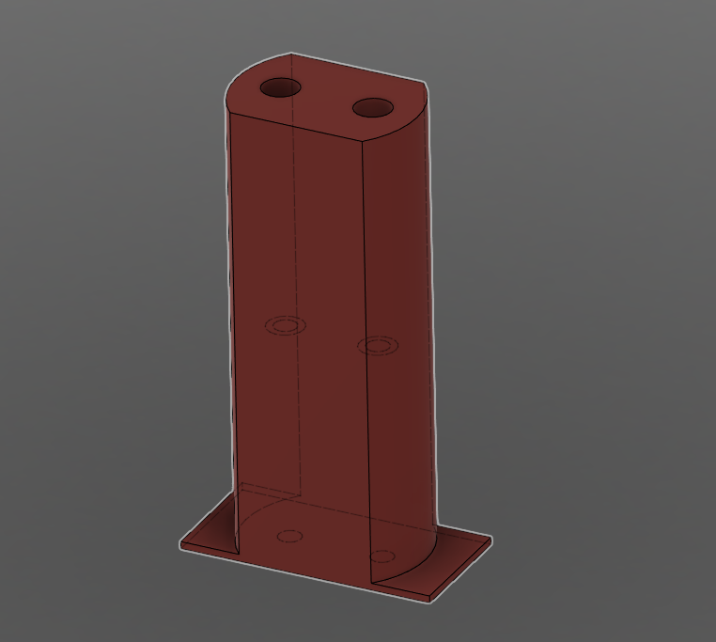
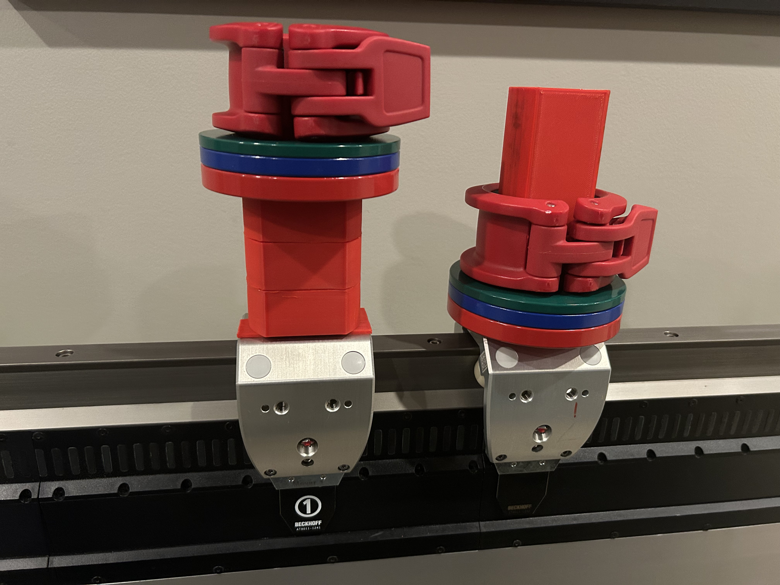
Tuning Hardware

Slide 14
Real Machine Video

Slide 15
Graphics | Icons
Examples for brackets and arrows
Note: For text arrows, type “minus + minus + right-arrow” - - > Auto correct will change it to →.

Slide 16
Graphics | Icons
Examples for shapes and accents
Background gradient example
Text label
highlight frame
NEW
on demand

Slide 17

Graphics | Icons
Examples for complex items
Team
of
Engineers
Customer
XML
XML
Note: For typographic approval signs in tables, use ✔(Alt + 10004), for rejection use ✖ (Alt + 10006), for non-existent use – (Alt + 0150).
<xml/>
<xml/>

Slide 18
Graphics | Icons
Examples for the use of colors
Element 1
Element 2
Element 3
Element 4
Element 1-1
Element 2-1
Element 3-1
Element 4-1
!
Text
Text
Text

Slide 19
Graphics | Example 1
Text
Text
Text
Text
Text

Slide 20
Graphics | Example 2
Text
Text
Text
Text
Text

Slide 21
Graphics | Example 3
Text
Text
Text
Text
Text
Text
Text
Text

Slide 22
Graphics | Example 4
Text
Text
Text
Text
Text
Text
Text
Text

Slide 23
Graphics | Example 5
Text
Text
Text
Text
Text
Text
Text
Text
Text
Text
Text
Text
Text
Text
Text
Text
Text
Text
Text

Slide 24
Graphics | Example 6
Text
Text 1
Text 2
Text 3
Text
Text
Text
Text
Text

Slide 25
Graphics | Hierarchy
Text
Text
Text
Text
Text
Text

Slide 26
Graphics | Timeline 1
Project 1
Project 4
Project 2
2020
1
2
3
4
5
6
7
8
9
10
11
12
Project 3

Slide 27
Graphics | Timeline 2
1 | 2 | 3 | 4 | 5 | 6 | 7 | 8 | 9 | 10 | 11 | 12
Project 1
Project 2
Project 3
Project 4

Slide 28
Graphics | Timeline 3
1st quarter | 2nd quarter | 3rd quarter | 4th quarter
Project 1
Project 2
Project 3
Project 4

Slide 29
Graphics | Pie chart
Information 1
Information 2

Slide 30
Graphics | Ring chart

Slide 31
Graphics | Bar chart 1
In all chart types, colors of single elements or data series can be customized as needed.

Slide 32
Graphics | Bar chart 2 with data table and legend keys at the bottom

Slide 33
Graphics | Bar chart 2 with legend on the right

Slide 34
Graphics | Bar chart 2 with legend on the right

Slide 35
Graphics | Bar chart 3

Slide 36
Graphics | Line chart

Slide 37
Table layout | Banded rows
Headline | Headline | Headline | Headline | Headline | Headline
Text | Text | Text | Text | Text | Text
Text | Text | Text | Text | Text | Text
Text | Text | Text | Text | Text | Text
Text | Text | Text | Text | Text | Text
Text | Text | Text | Text | Text | Text
Text | Text | Text | Text | Text | Text
Text | Text | Text | Text | Text | Text
Text | Text | Text | Text | Text | Text
Text | Text | Text | Text | Text | Text
If possible, set the text margin in the first column to 1.25 cm.

Slide 38
Table layout | Banded columns
Headline | Headline | Headline | Headline | Headline | Headline
Text | Text | Text | Text | Text | Text
Text | Text | Text | Text | Text | Text
Text | Text | Text | Text | Text | Text
Text | Text | Text | Text | Text | Text
Text | Text | Text | Text | Text | Text
Text | Text | Text | Text | Text | Text
Text | Text | Text | Text | Text | Text
Text | Text | Text | Text | Text | Text
Text | Text | Text | Text | Text | Text
If possible, set the text margin in the first column to 1.25 cm.

Slide 39
Table layout | First column with color accent
Headline | Headline | Headline | Headline | Headline | Headline
Text | Text | Text | Text | Text | Text
Text | Text | Text | Text | Text | Text
Text | Text | Text | Text | Text | Text
Text | Text | Text | Text | Text | Text
Text | Text | Text | Text | Text | Text
Text | Text | Text | Text | Text | Text
Text | Text | Text | Text | Text | Text
Text | Text | Text | Text | Text | Text
Text | Text | Text | Text | Text | Text
If possible, set the text margin in the first column to 1.25 cm.

Slide 40
Table layout | First column and total row with color accent
Headline | Headline | Headline | Headline | Headline | Headline
Text | Text | Text | Text | Text | Text
Text | Text | Text | Text | Text | Text
Text | Text | Text | Text | Text | Text
Text | Text | Text | Text | Text | Text
Text | Text | Text | Text | Text | Text
Text | Text | Text | Text | Text | Text
Text | Text | Text | Text | Text | Text
Text | Text | Text | Text | Text | Text
Total | Result | Result | Result | Result | Result
If possible, set the text margin in the first column to 1.25 cm.

Slide 41
Thank you for your attention

Slide 42
Contact
Phone: 952-890-0000
Fax: 952-890-2888
E-Mail: beckhoff.usa@beckhoff.com
Web: www.beckhoff.com
Beckhoff Automation LLC
Headquarters
13130 Dakota Ave
Savage, MN 55378
USA
© Beckhoff Automation GmbH & Co. KG
All images are protected by copyright. The use and transfer to third parties is not permitted.
Beckhoff®, TwinCAT®, EtherCAT®, EtherCAT G®, EtherCAT G10®, EtherCAT P, Safety over EtherCAT®, TwinSAFE®, XFC®, XTS® and XPlanar® are registered trademarks of and licensed by Beckhoff Automation GmbH. Other designations used in this presentation may be trademarks whose use by third parties for their own purposes could violate the rights of the owners.
The information provided in this presentation contains merely general descriptions or characteristics of performance which in case of actual application do not always apply as described or which may change as a result of further development of the products. An obligation to provide the respective characteristics shall only exist if expressively agreed in the terms of contract.
Notes:
42

